Slide 1

Household Income vs. Housing Ownership
ST 599 – Big Data Project 1
Sarah Guermond
Andy Olstad
Jasmine Pahukula
Tim Skalland
4 / 25 / 2014

Slide 2
Overview
Data: American Community Survey (ACS)
Distributed each yearly
The ACS collects social, economic, housing and demographic data.
3 year ACS (2010-2012)
Notes:
The American Community Survey (ACS) is distributed each year to a small sample of the population in each state including Puerto Rico.
It provides updated information for communities to aid in planning efforts in between the main 10-year census survey.
The ACS collects social, economic, housing and demographic data. This report will focus on the economic and housing information for each state.
We use the 2010-2012 ACS set in order to answer the following question of interest.

Slide 3
Question of Interest
How different are the mean household incomes for different household ownership in the US?
Household ownership types:
Own with a mortgage or loan
Own free and clear
Rented
Occupied without payment of rent
Notes:
We chose household income because we figured people would collectively contribute to the payment of the house.
Households is kind of vague in the description since 2006 the survey included nursing homes, correctional facilities, military barracks and college university housing. How do these people respond?

Slide 4
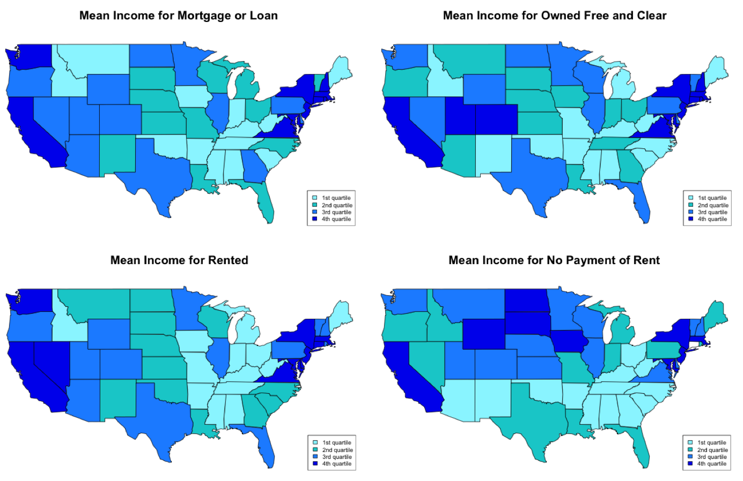
Findings
Notes:
(This slide can be brief) East coast/west coast has high income across all ownership levels. This is probably due the high cost of living on the coasts.

Slide 5
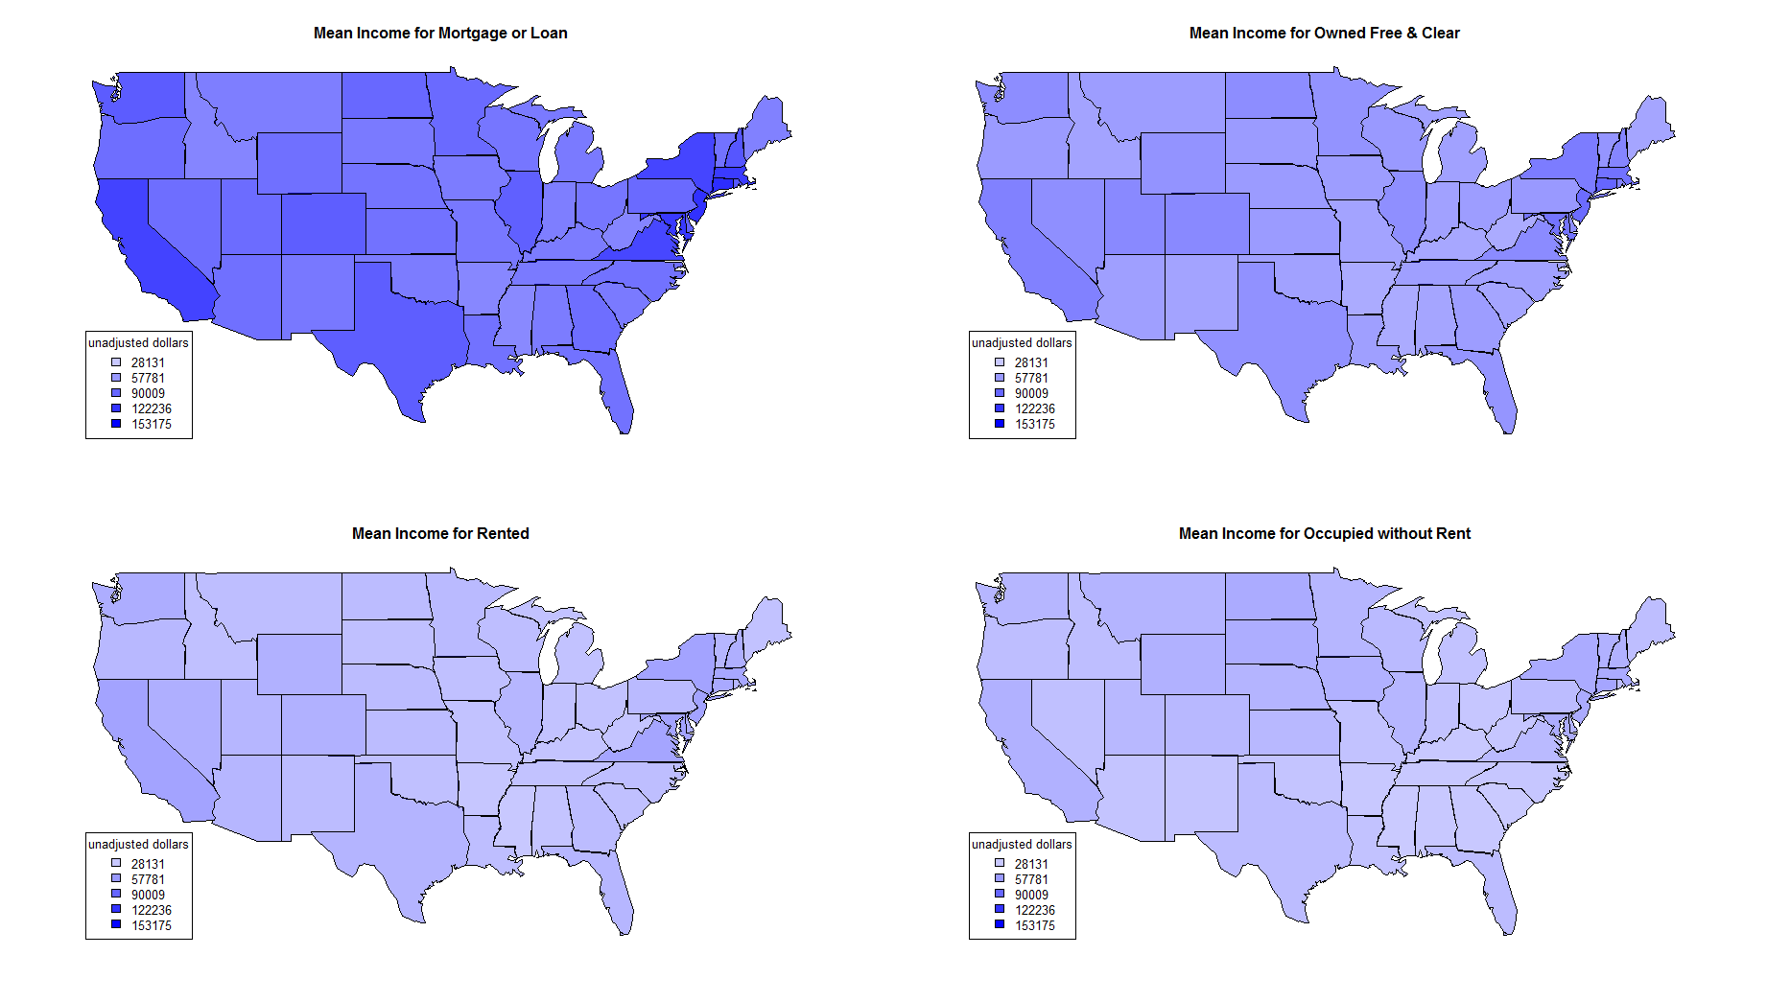
Findings
Notes:
(This slide can be brief) East coast/west coast has high income across all ownership levels. This is probably due the high cost of living on the coasts.

Slide 6
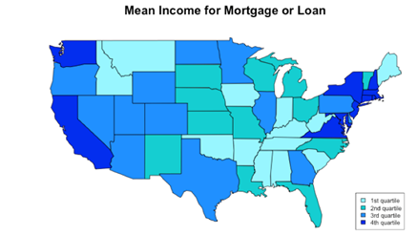
Findings
Highest mean in
D.C.
($154,465)
Connecticut ($126,760)
New Jersey ($124,364)
Maryland ($119,358)
Massachusetts ($118,119)
Similar results for those owning free and clear.

Slide 7
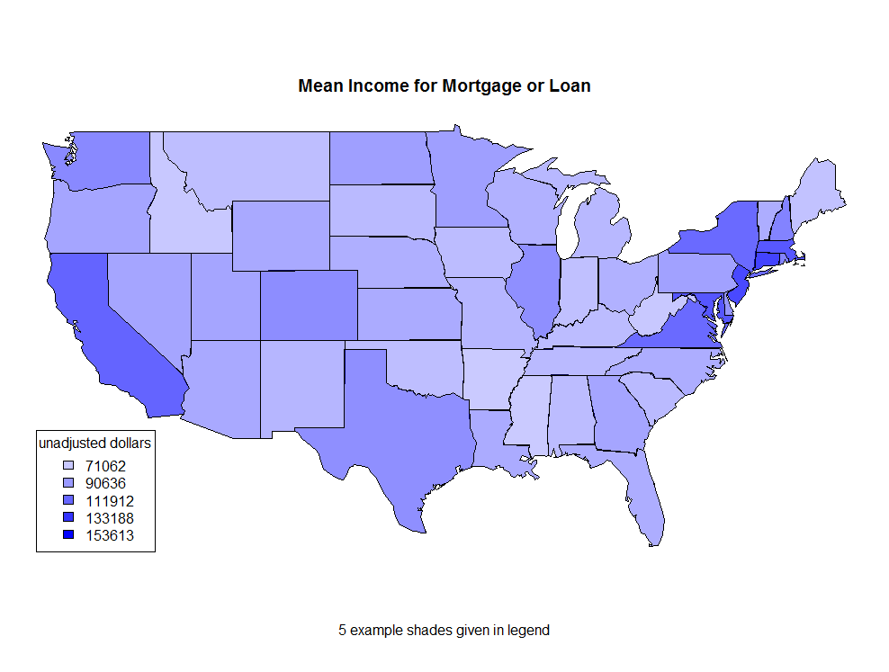
Findings
Highest mean in
D.C.
($154,465)
Connecticut ($126,760)
New Jersey ($124,364)
Maryland ($119,358)
Massachusetts ($118,119)
Similar results for those owning free and clear.

Slide 8
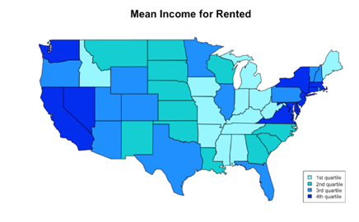
Findings
Highest mean in
D.C.
($62,337)
Hawaii ($58,077)
Alaska ($54,918)
California ($52,423)
Maryland ($52,404)
Notes:
D.C., Hawaii, and Alaska (and maybe California) may be high here due to moving for a job (not a permanent resident of that state/area).

Slide 9
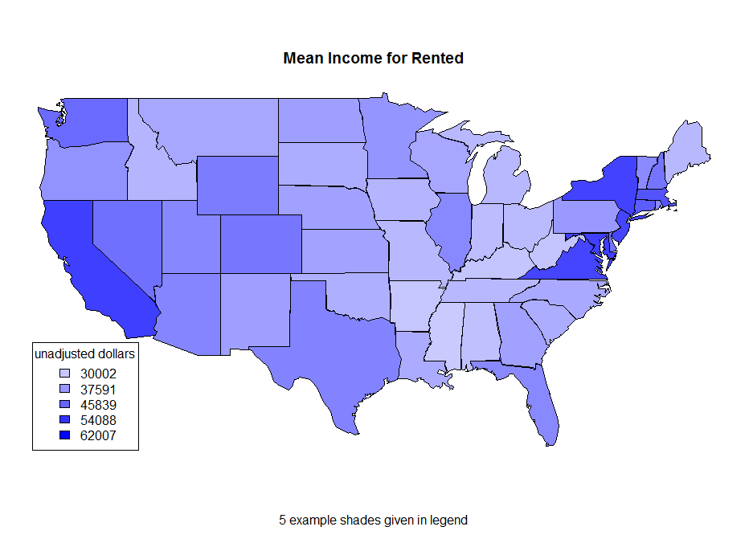
Findings
Highest mean in
D.C.
($62,337)
Hawaii ($58,077)
Alaska ($54,918)
California ($52,423)
Maryland ($52,404)
Notes:
D.C., Hawaii, and Alaska (and maybe California) may be high here due to moving for a job (not a permanent resident of that state/area).

Slide 10
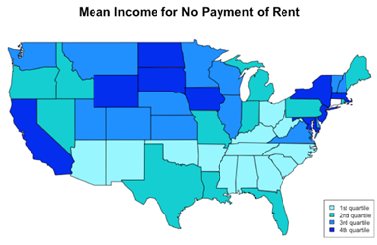
Findings
Highest mean in
Connecticut ($50,264)
D.C.
($49,266)
Hawaii ($47,860)
Massachusetts ($47,224)
New Jersey ($47,081)

Slide 11
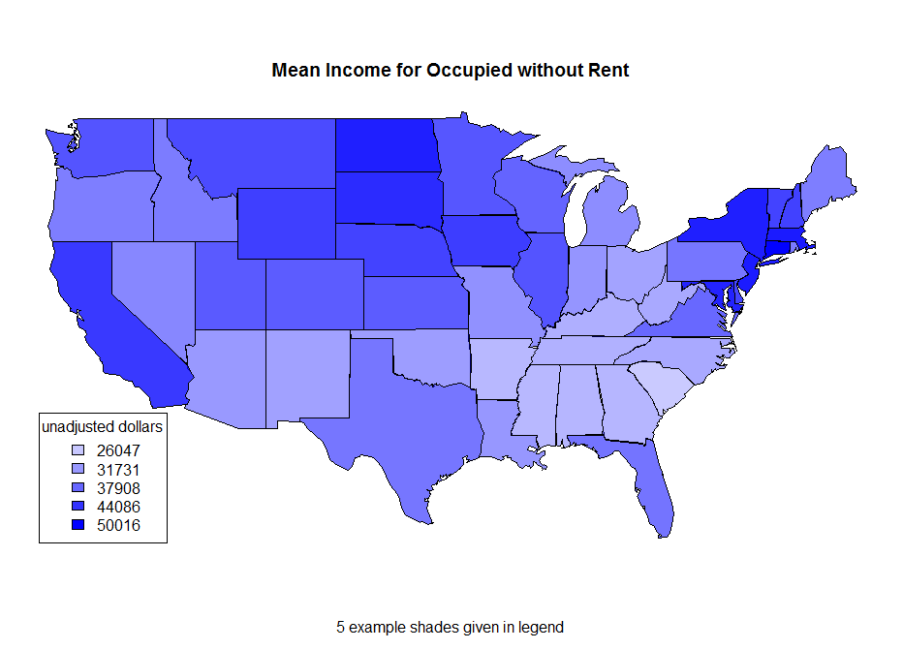
Findings
Highest mean in
Connecticut ($50,264)
D.C.
($49,266)
Hawaii ($47,860)
Massachusetts ($47,224)
New Jersey ($47,081)

Slide 12
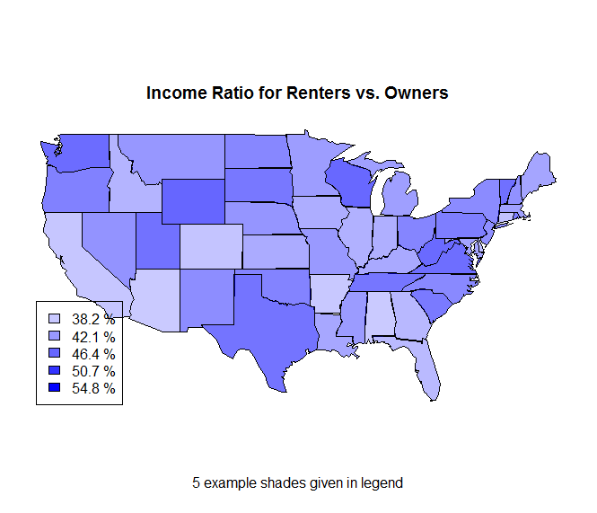
Findings

Slide 13
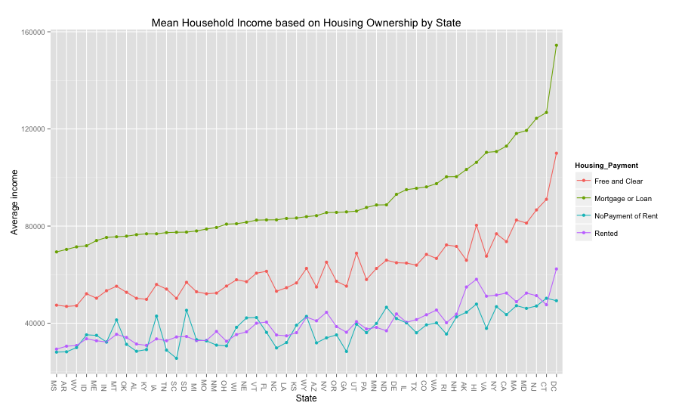
Findings
Notes:
We also notice that households owning with a mortgage or loan had higher mean income than owning free and clear across all states. A possible explanation may be due to retirees (ie: smaller income but likely to have paid off the house). We see that renting and occupying without rent were fairly similar within all states.

Slide 14
Findings
It was interesting to see:
Mississippi, Alabama and Arkansas were near the lowest mean household incomes across all ownership types.
Midwest has high income/occupy with no rent
Florida has higher income for owned free and clear than surrounding region.
Notes:
Military housing fell under No Payment of Rent. As did tenant farmers, parsonages (clergy housing), caretakers, and housing owned by others not living there.

Slide 15
Obstacles and Solutions
Git setup:
Problem: getting git to work and sync.
Solutions:
Delete local connection, create new version control project in Rstudio, paste changes to new file
Use github for Mac/Windows
File downloads:
Problem: Automating the downloading process of each state from the web.
Solution: Download combined US household data.
Problem: Combined US household data comes in 4 files
Solution: Download all 4, use system() to merge in command line using cat.
Notes:
Files downloads: mention the process…1. Used CA only, 2. started to get a loop for all states, 3. Found US total data, 4. Merged US data over 4 data sets

Slide 16
Obstacles and Solutions
Data import:
Problem: ~200 x 4 million dataset breaks R
Solution: Use cut to find columns of interest
Code compatibility:
Problem: 1 mac, 3 windows
Solution: upload modified data file to git repo
Accidental branch diversion:
Problem: Accidental split/merge
Solution: Version control allows manual reversion to previous versions
Notes:
Code Compatibility: Windows cannot run system commands in R
Accidental branch diversion: Sometimes split into two versions, merged and then the code broke. Version control allowed us to go back to previous versions and correct the merging errors

Slide 17
Future Work
Different groups
per state based on year
by region (East, South, West, Midwest)
Examine counts – what proportion of households fall into what category in each state? Is it similar across states.
Examine differences between each of the 4 household ownership types
Hypothesize that free & clear owners are retired, mortgage payers are still working
Take into consideration negative and null income
Include weighting, inflation.
Notes:
Negative and Null Income: We ignored NAs and averaged in negatives.
Weighting: This analysis pretended the ACS data was from a simple random sample. When we ran a few states with the weighting, average incomes increased. We also did not adjust for inflation.

